Slide 1

Pattern Recognition
ELEC97112/ELEC97113
ELEC97112/ELEC97113 – Computer Vision & Pattern Recognition - K. Mikolajczyk & A. Spiers
Coursework Overview

Slide 2


Slide 3
Coursework
Work in pairs
4 page report (overleaf template provided)
Non-key figures can be placed in appendix (please reference carefully)
Submit Matlab code
Deadline – 15th February 23:59
Topic – Robotics & Haptics
This session we’ll talk about the background and motivation for the coursework

Slide 4
Haptics
Science and Technology related to the Sense of Touch

Slide 5
Haptics
Kinaesthetic
Tactile

Slide 6
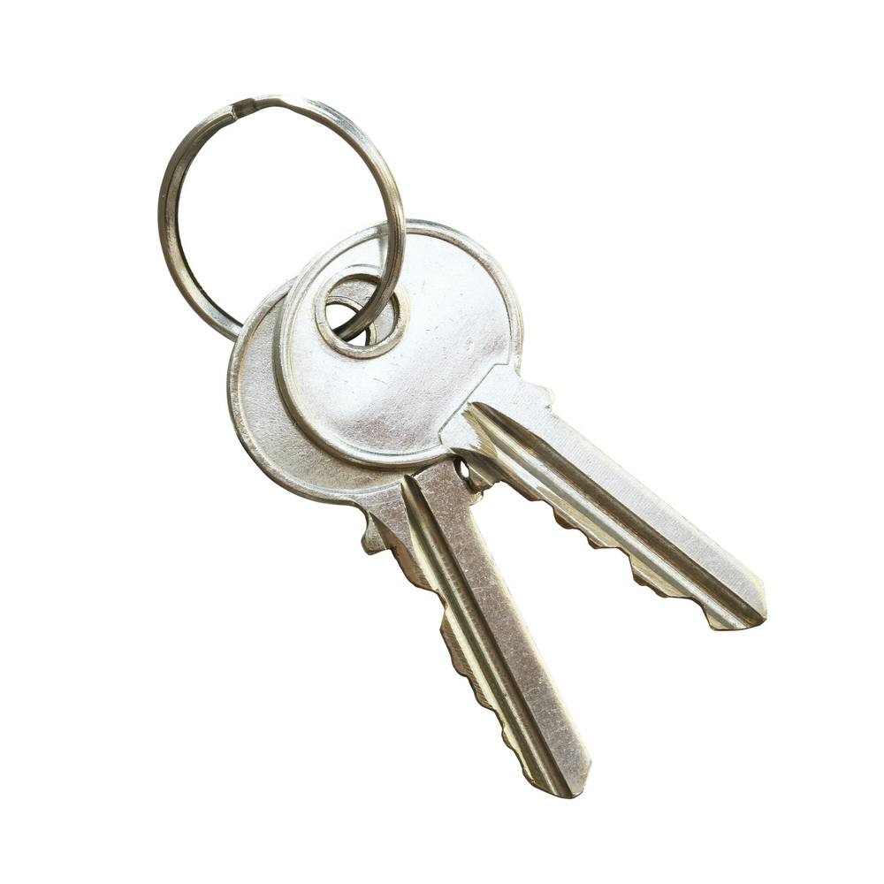

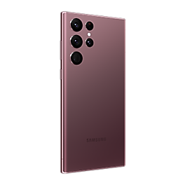
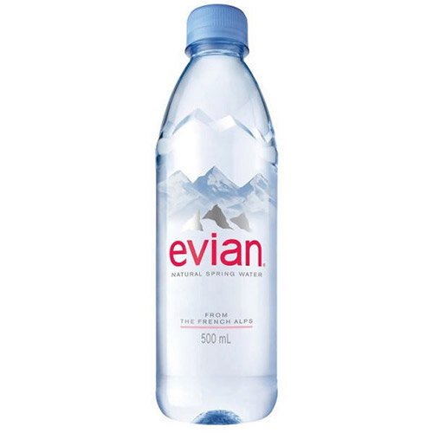
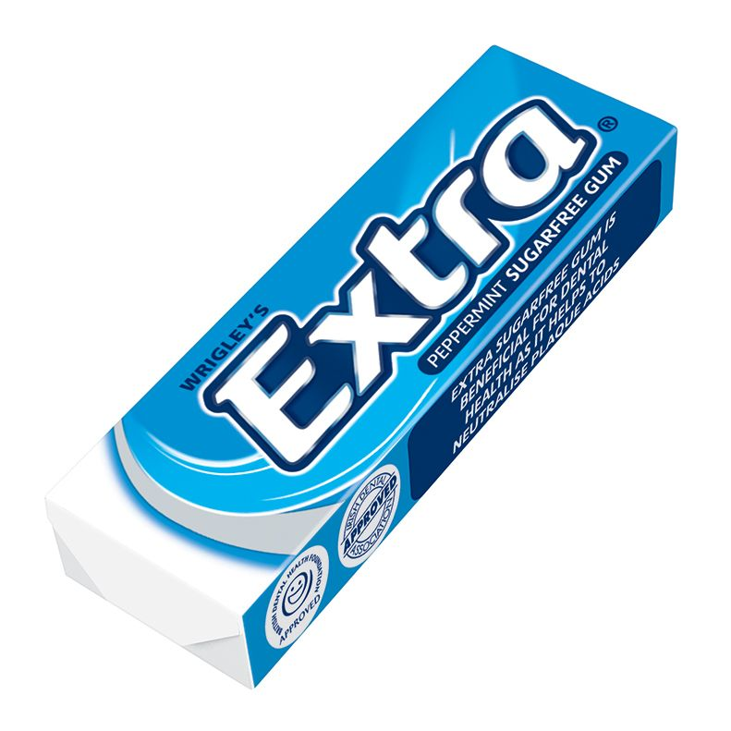
Looking for keys

Slide 7
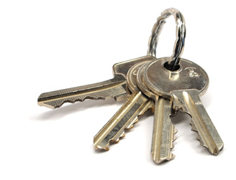
Haptics
Haptics can help us when vision fails
He can augment the occluded view by using his sense of touch to identify key-like object properties
Hard
Cold
Articulated (keys can move independently to key ring)

Slide 8

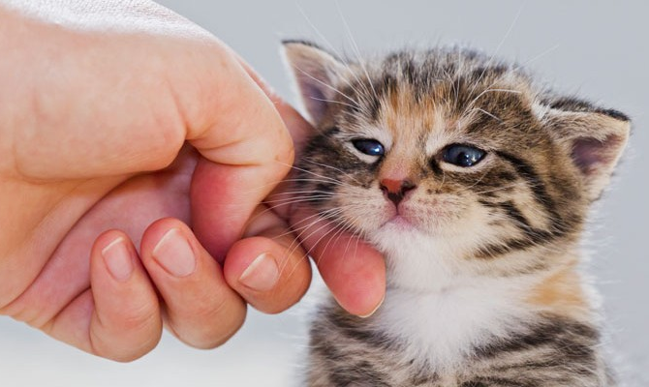
Haptics
We often use vision to identify objects and infer information
Touch has generally been much less researched than vision in artificial systems
Touch gives us different types of information
Touch sensing is often associated with manipulation

Slide 9
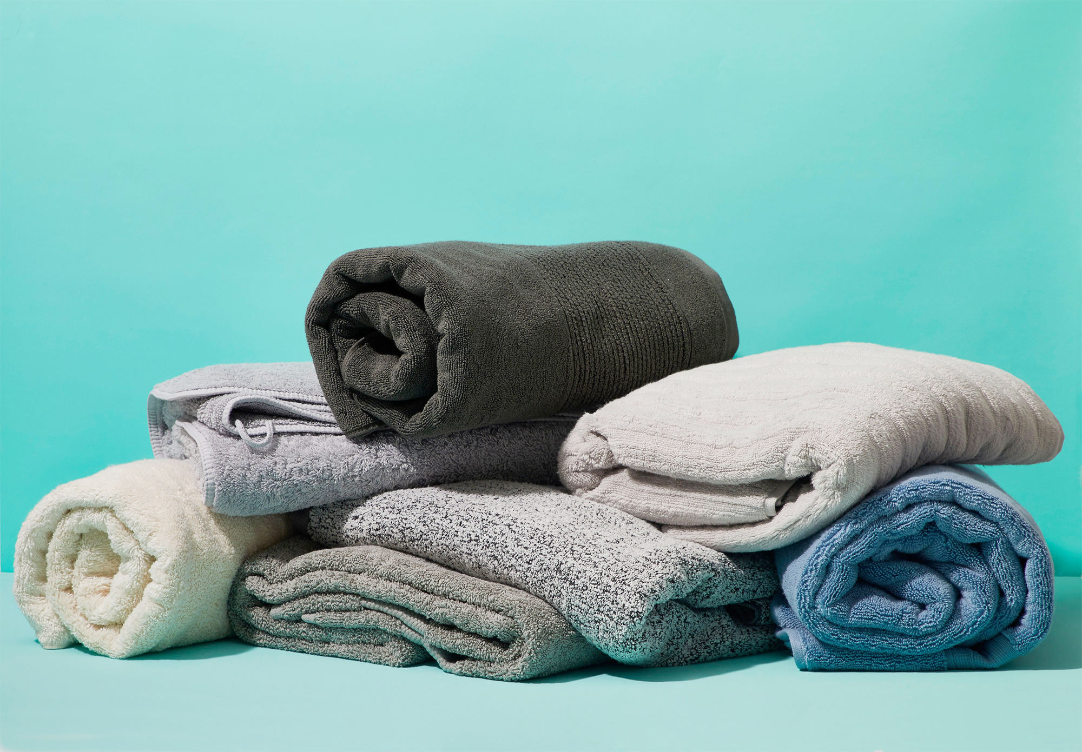
Haptics
Some properties cannot be determined only by vision
For example, how soft something is
It’s hard to guess which towel is the softest only from this image
It’s natural to want to touch items when choosing them

Slide 10
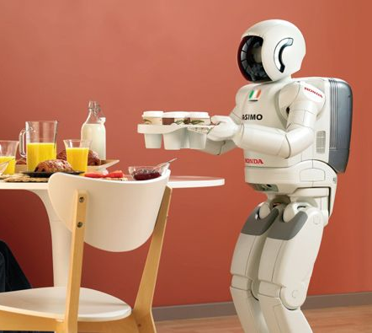
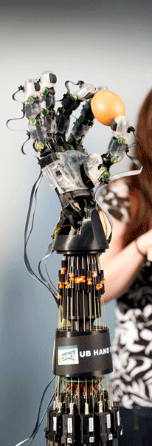
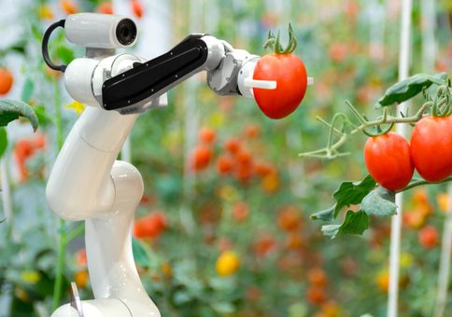
Robots + Haptics
Robots that can perform haptic sensing is a growing area of interest
Close local control loops
Grasping & manipulation
Make up for otherwise incomplete sensory data about the world
Identify objects by touch
Identify object properties by touch
E.g. weight, firmness, inertia

Slide 11
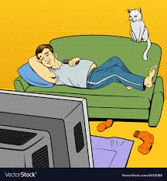
Haptics is an active sense
You can watch stuff passively
Time for an experiment…
Find any nearby object
Put a finger on it
What do you feel?
Push / Squeeze it
What do you feel?
Slide your finger back and forth
What do you feel?

Slide 12
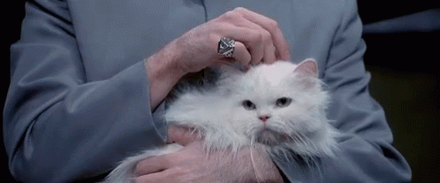
Time Series (Haptic) Data
Touch is an active sense
The way we touch something affects what we feel

Slide 13

Time Series (Haptic) Data
Different objects affect haptic sensation
Different stages of touch affect haptic sensation
Different stages of touch happen at different times

Slide 14
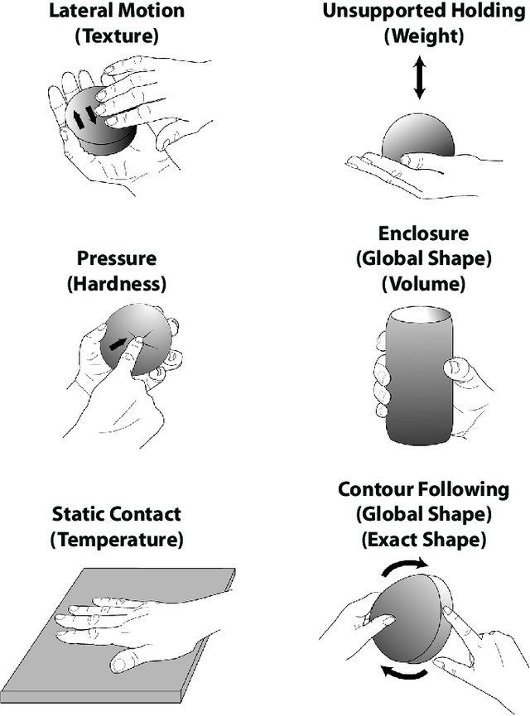
Exploratory Procedures
‘Active Touch’
Different motions / manipulation actions lead to different kinds of haptic data
Made famous by Lederman & Klatzky (1987)
Robots also need to make use of sensors and active touch

Slide 15
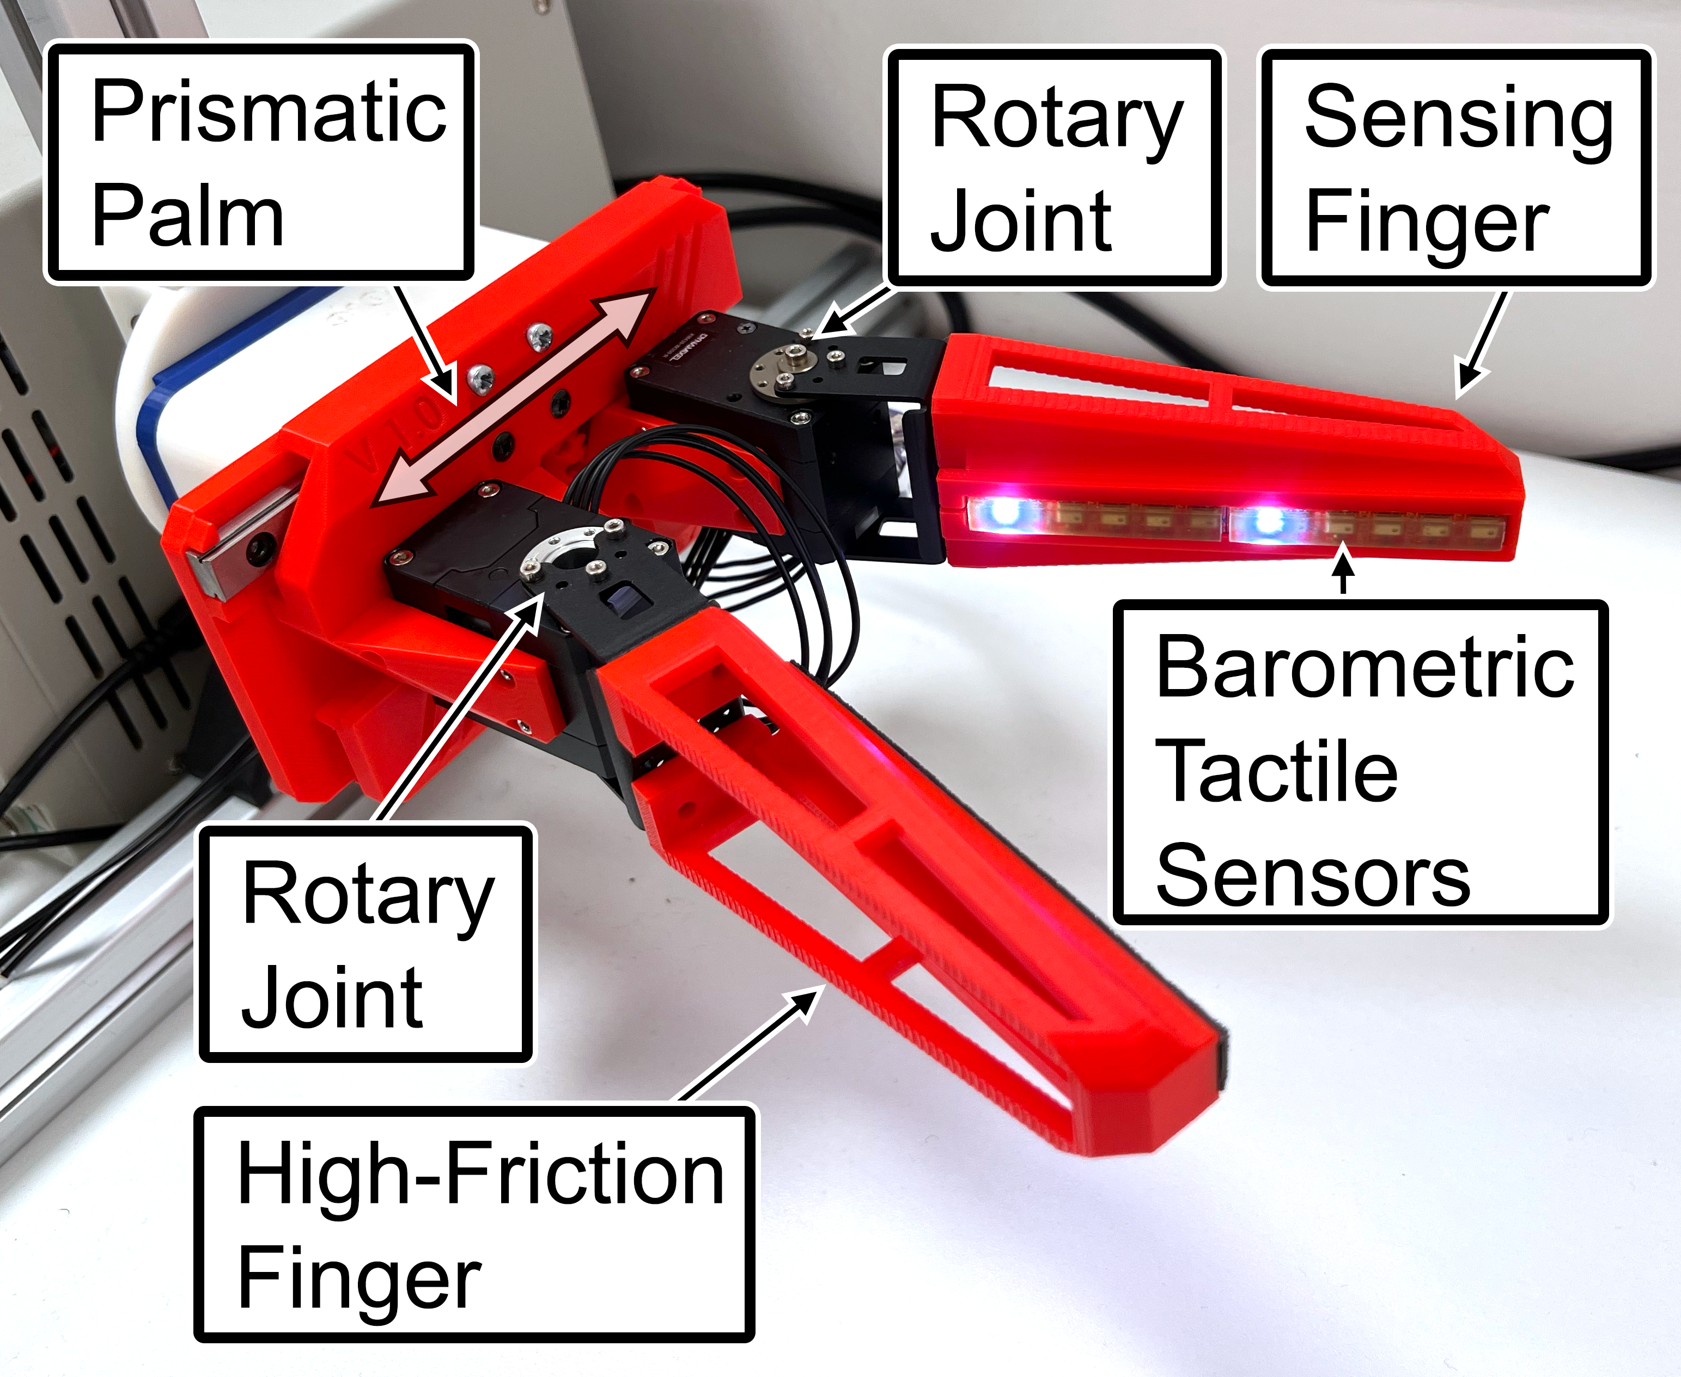
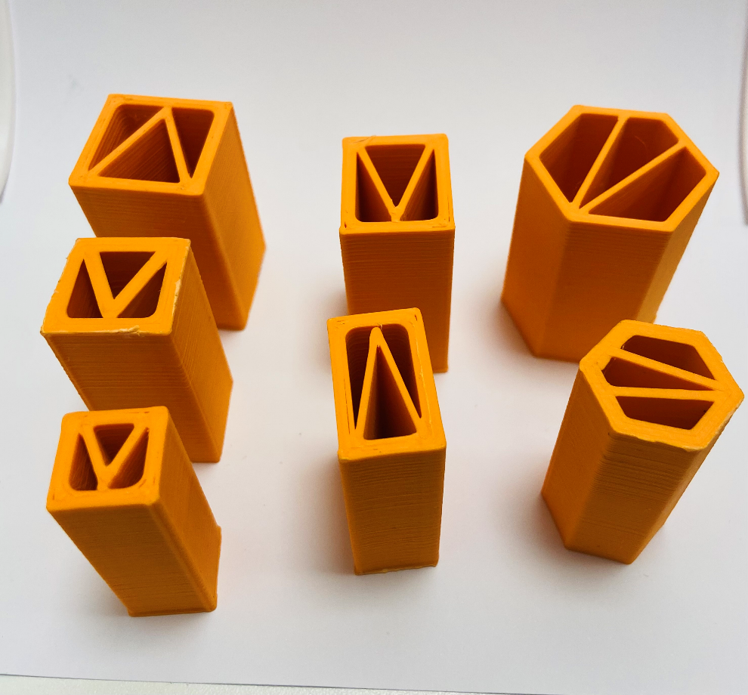
Notes:
This two-fingered hand has one rotary joint at each finger base and features a prismatic palm, which can dynamically adjust the distance between the two finger bases. One finger is equipped with a barometric tactile sensor array, whereas the other finger has a high-friction surface.

Slide 16
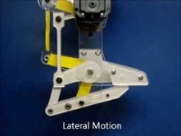
Active Exploration (2011)

Slide 17
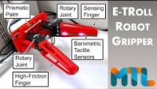
Active Exploration (2022)

Slide 18
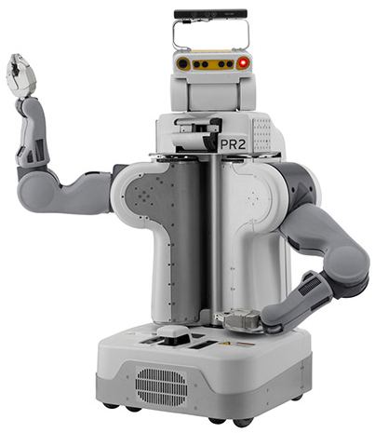
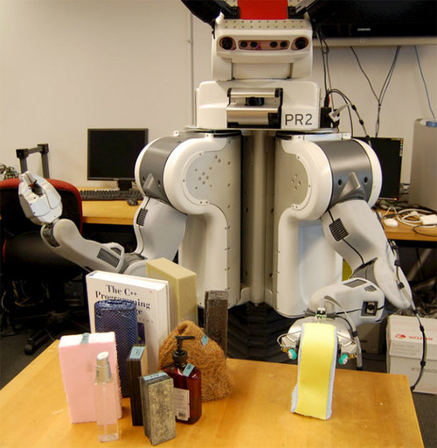
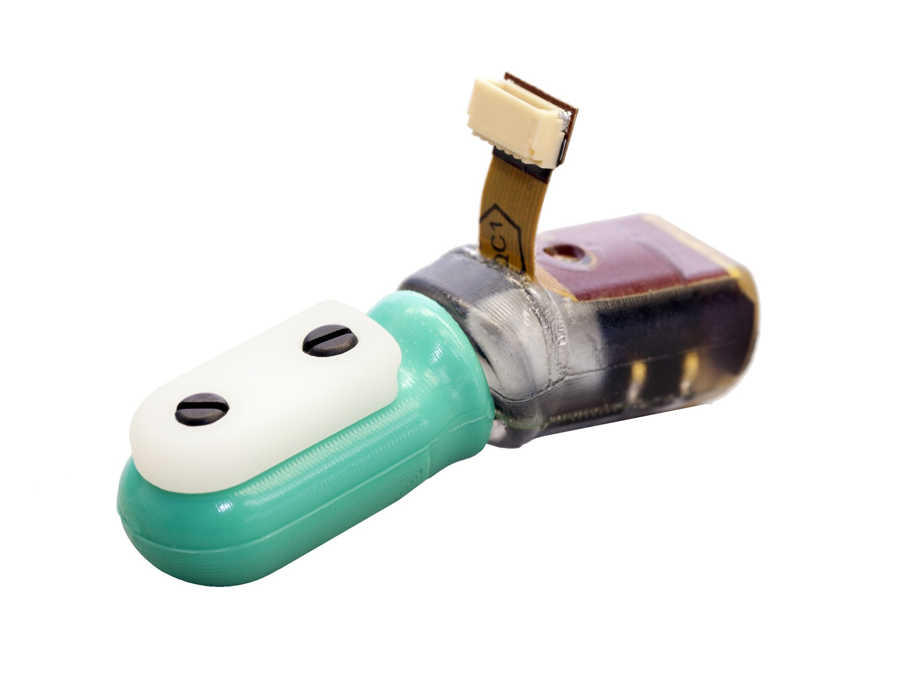
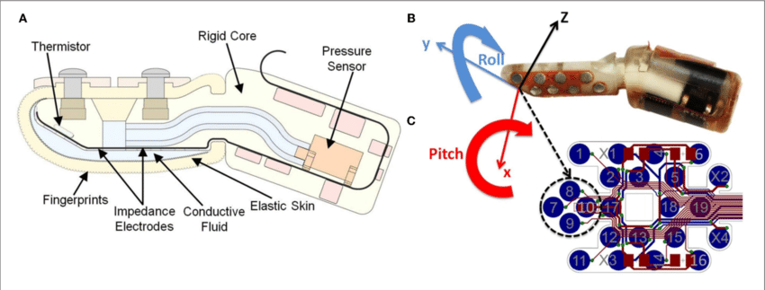
PENN Haptic Adjective Corpus
A PR2 robot performs five exploratory procedures
On 51 objects
Using multi-modal tactile sensors
The researchers were mostly interested in adjective labelling

Slide 19
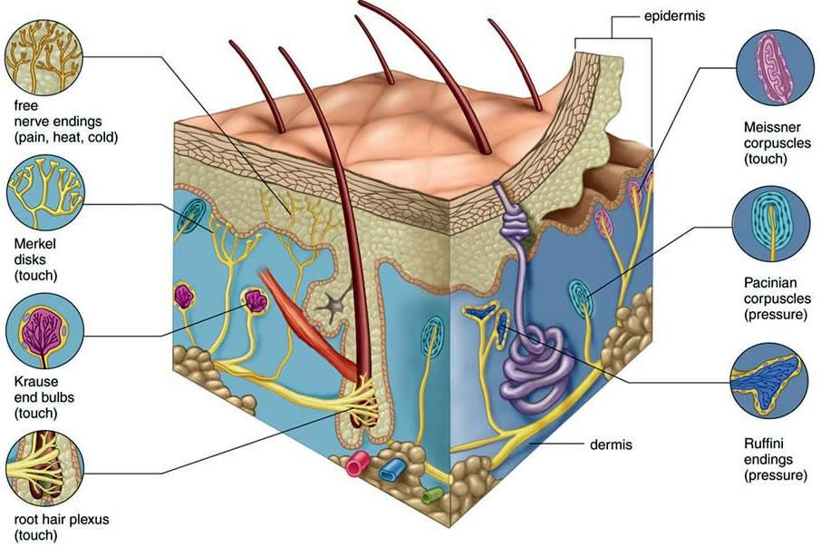
Human tactile sensors (note the plural!)

Slide 20
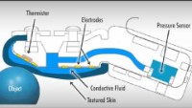
The BioTac Sensor

Slide 21
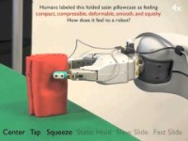

Slide 22
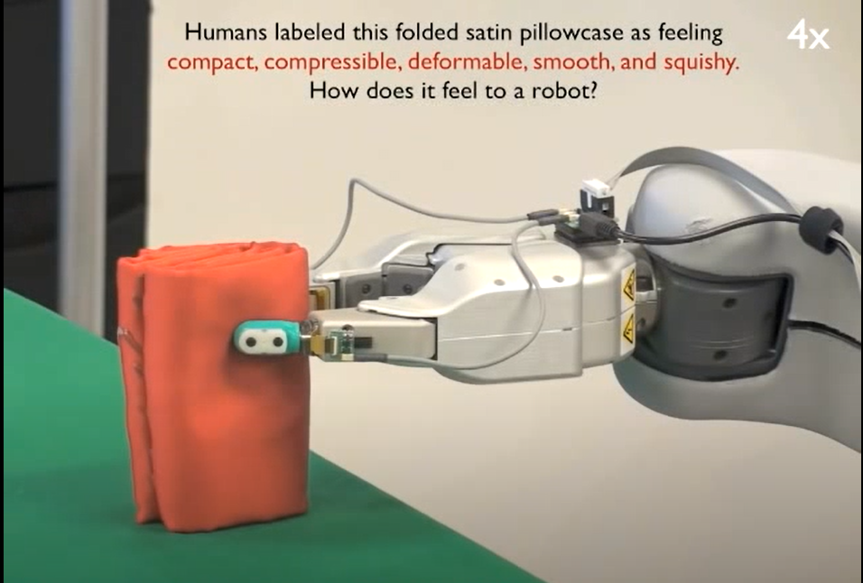
Our Dataset
We are only going to look at the Hold action
And only six objects
That’s still a lot of data
So we’re going to use Pattern Recognition to make sense of it

Slide 23
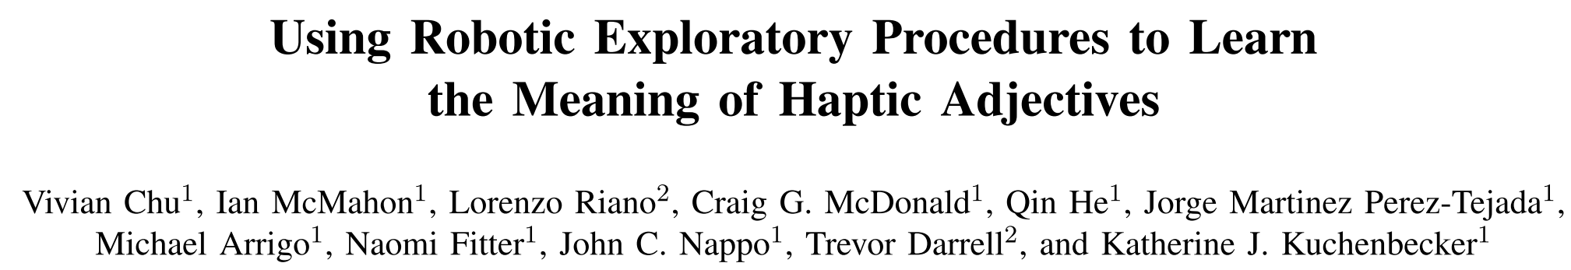
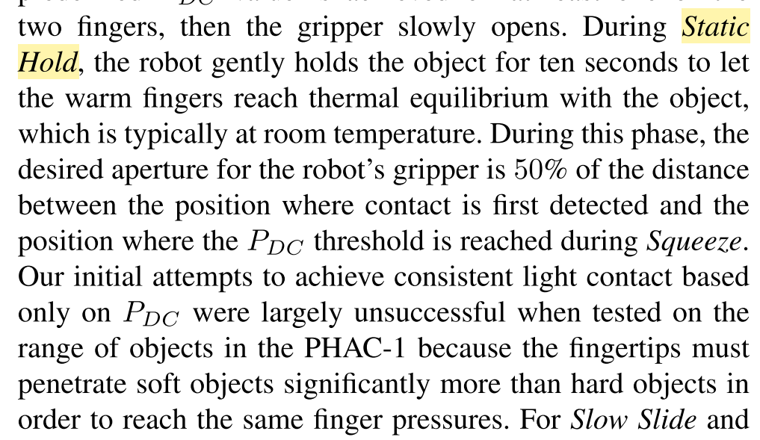

Slide 24
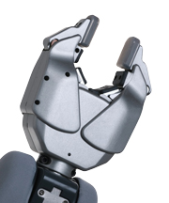
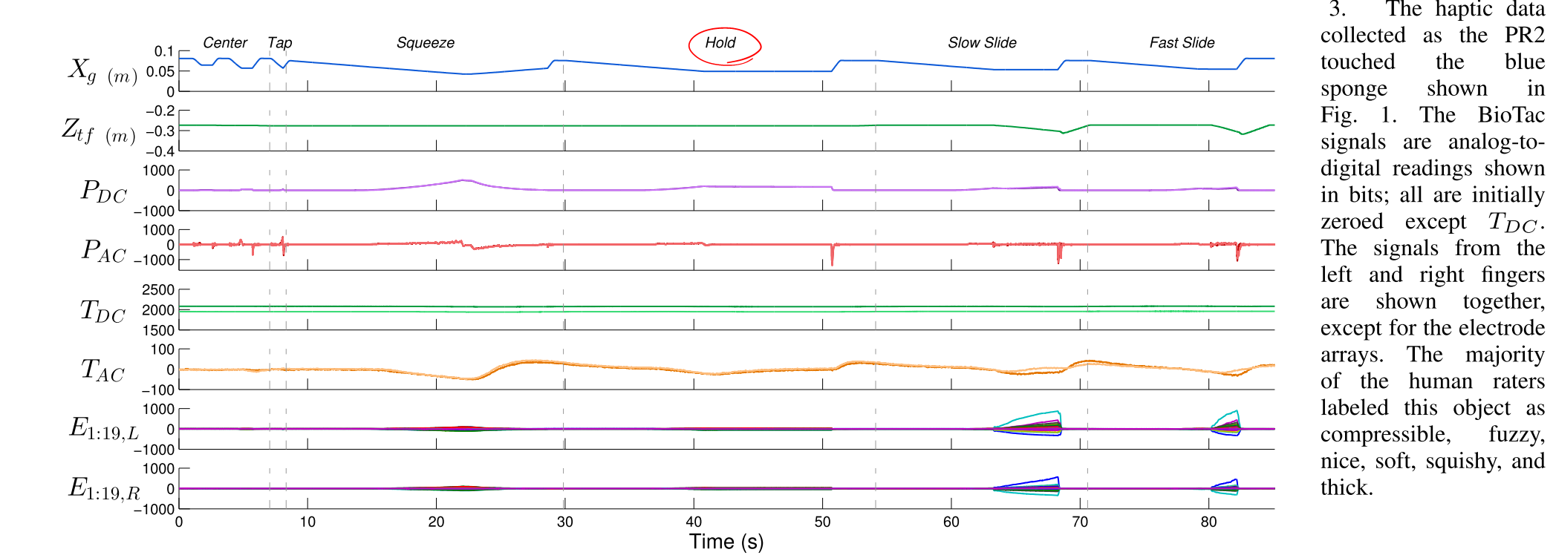
X_{g} is grasp aperture, Z_{tf} is gripper height
X_{g}

Slide 25
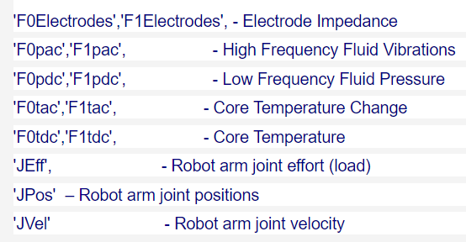

Slide 26
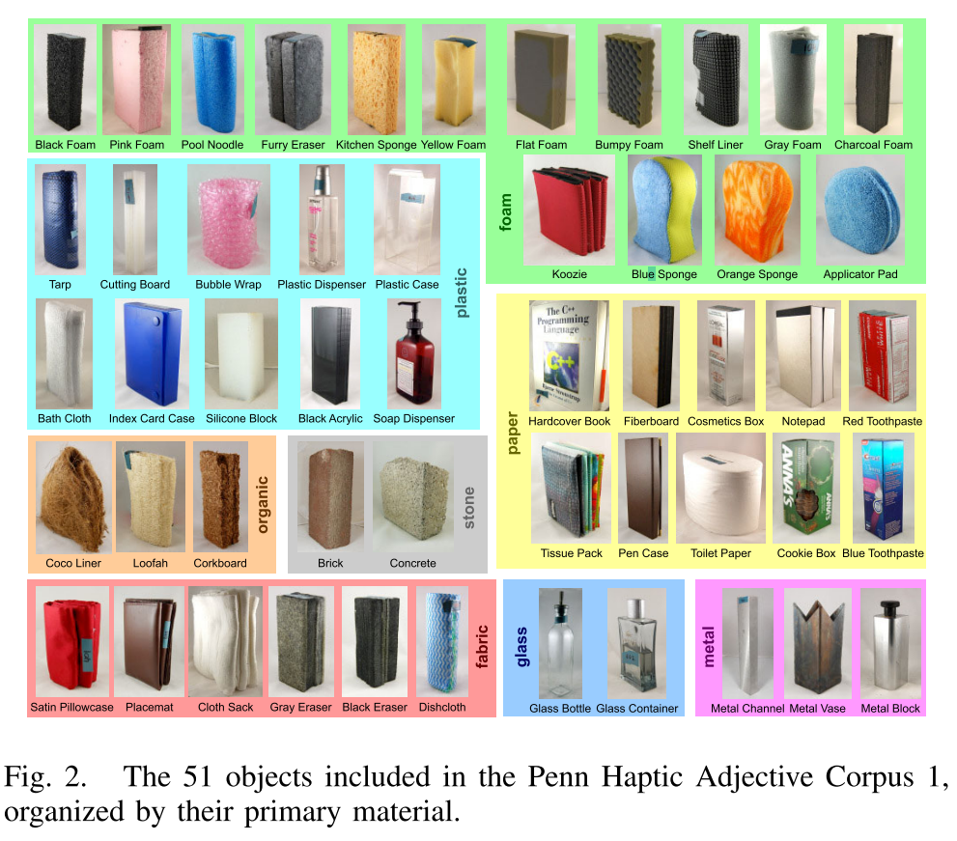
Objects
If you are curious, you can find pictures of the objects in that paper

Slide 27
Other Points
You can use Matlab’s built in functions for the coursework
You cannot use functions downloaded from Matlab File Exchange
Section 1 – You do not have to show all data for your time step justification
Be concise – show enough to make your decision clear

Slide 28
Pattern Recognition Course & Coursework Outline
Dimensionality Reduction Principle Component Analysis (PCA)
Linear Discriminant Analysis (LDA)
Data Representations Distance Metrics Clustering Algorithms
Bagging and Boosting Ensemble Learning
Time Series Data Analysis

Slide 29
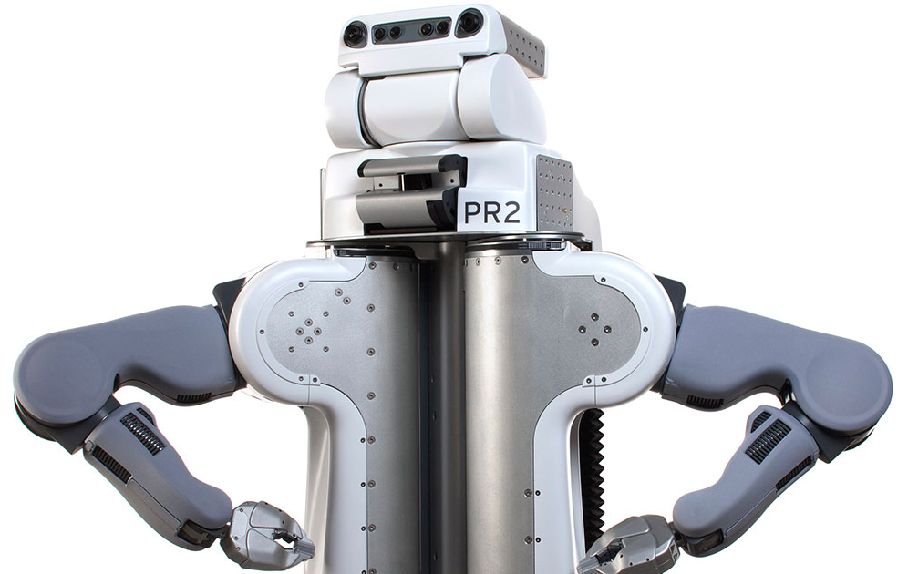
Questions?

